Slide 1
HOSPITAL MANAGEMENT
SYSTEM
Done By:
GROUP No: 28
SEVAKULA JYOTHI B180359CS
BILLA AMULYA B180404CS
BHUKYA VASANTH KUMAR B180441CS
PACHIGALLA BHARATH TEJA B180953CS
CHEERALA NAVEEN KUMAR B180383CS

Slide 2
THE PROJECT
The System is a web application intended to convey the patients and hospital management about various sectors like availability of doctors, medical bills and also other important aspects which could enable the management of hospitals for a proper growth and functionality. This application is mainly intended for the social community all well as the public and private hospital in a city.

Slide 3
1. This project enables a hospital to store the patients details in its database.
2. Patients can easily view the hospital services and book appointments in advance based on their time-slot.
3. The system helps doctors and patients to store prescription and other services.
4. Enables admin to easily update the doctors list and their time of availability.

Slide 4
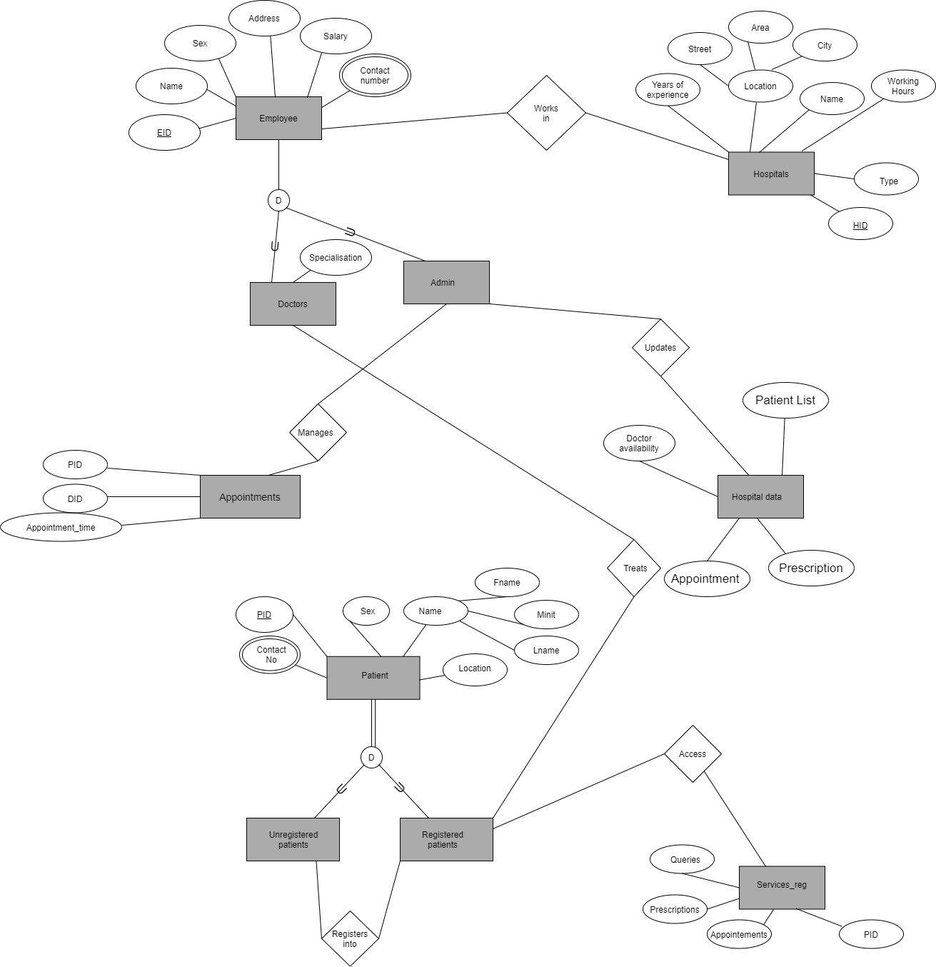
E-R DIAGRAM

Slide 5
RELATIONAL DATABASE DESIGN
The following tables are used in our project :
ADMIN TB
APPOINTMENT TB
CONTACT TB
DOCTOR TB
FEEDBACK TB
PATIENT REG TB
PRESCRIPTION TB

Slide 6
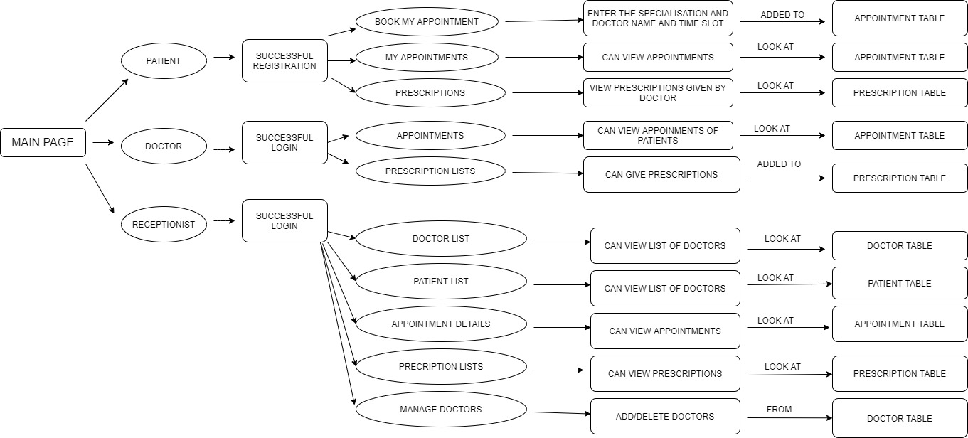
USER INTERFACE DESIGN

Slide 7
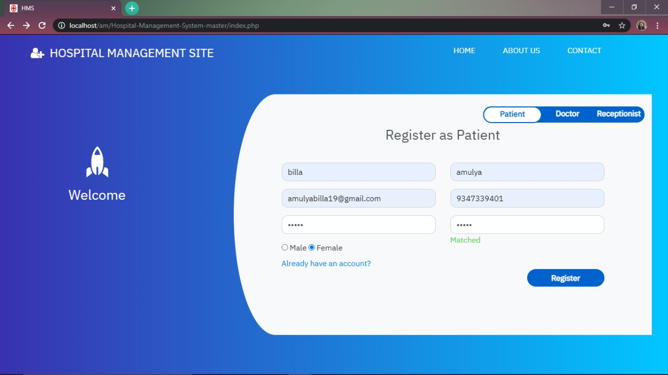
IMPLEMENTATION

Slide 8
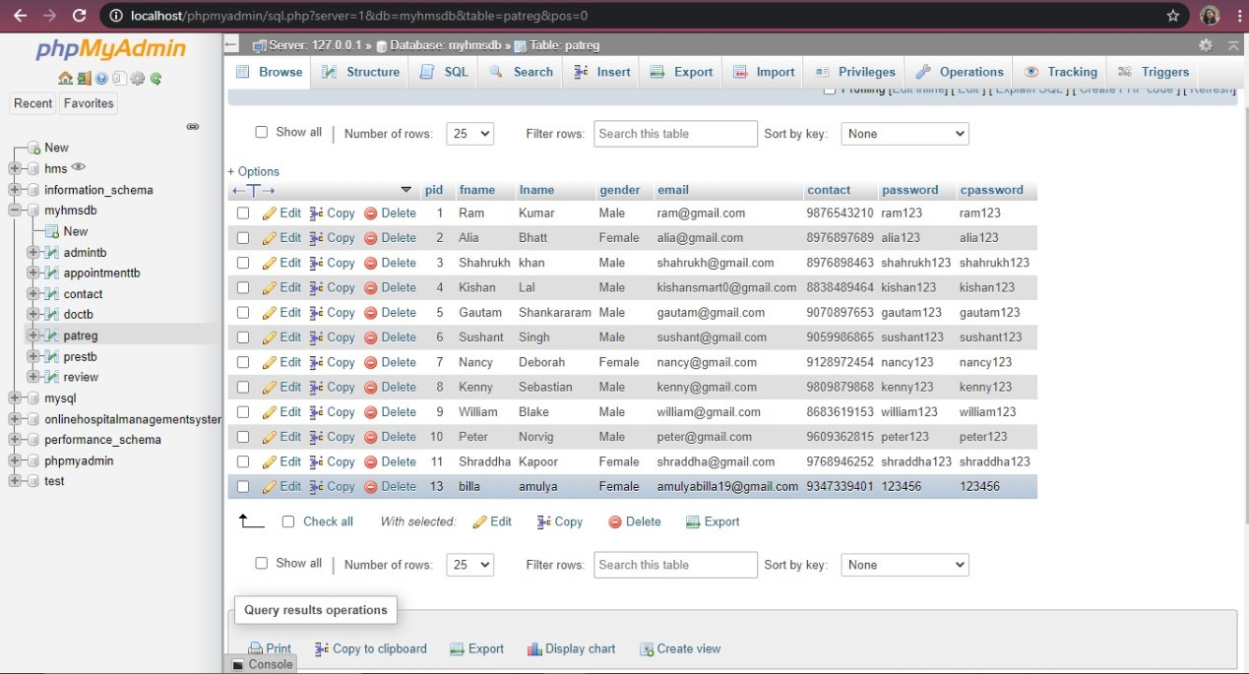

Slide 9
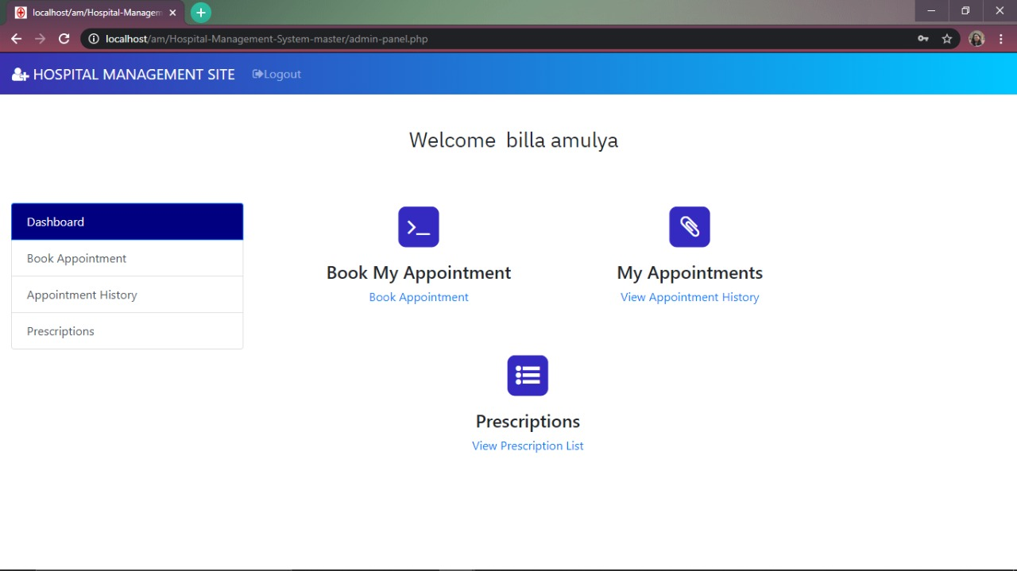

Slide 10
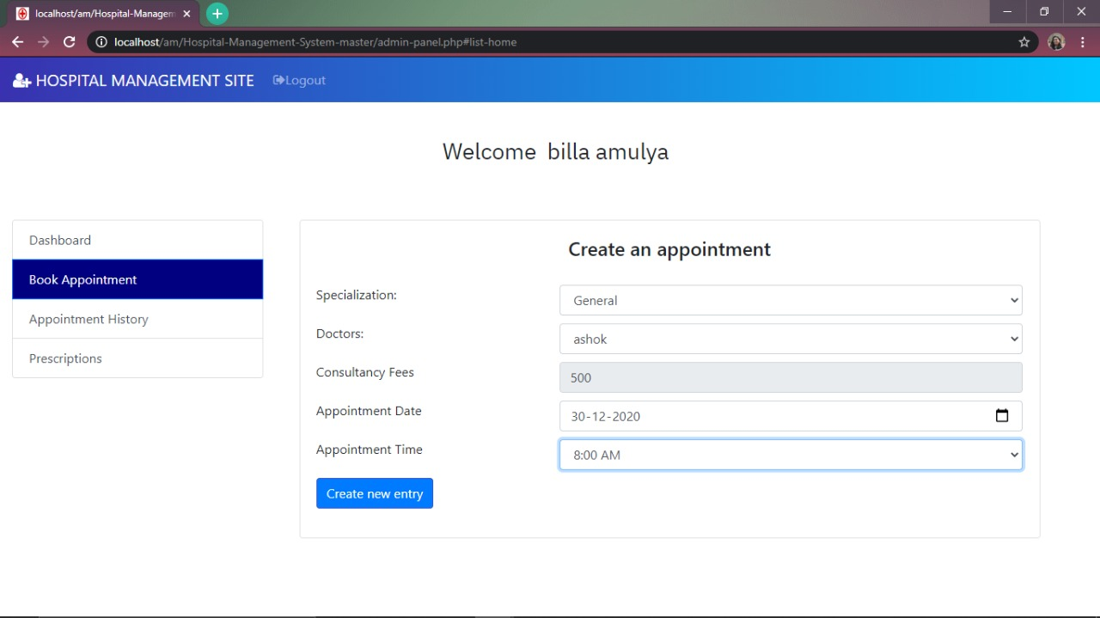

Slide 11
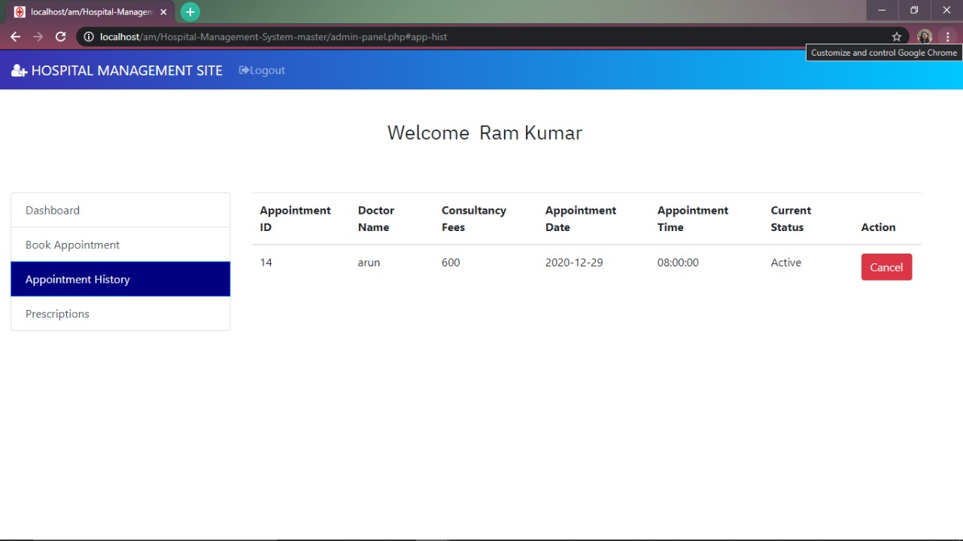

Slide 12
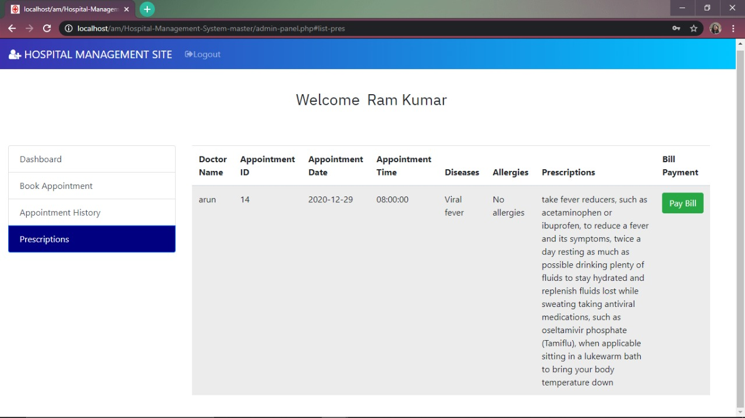

Slide 13
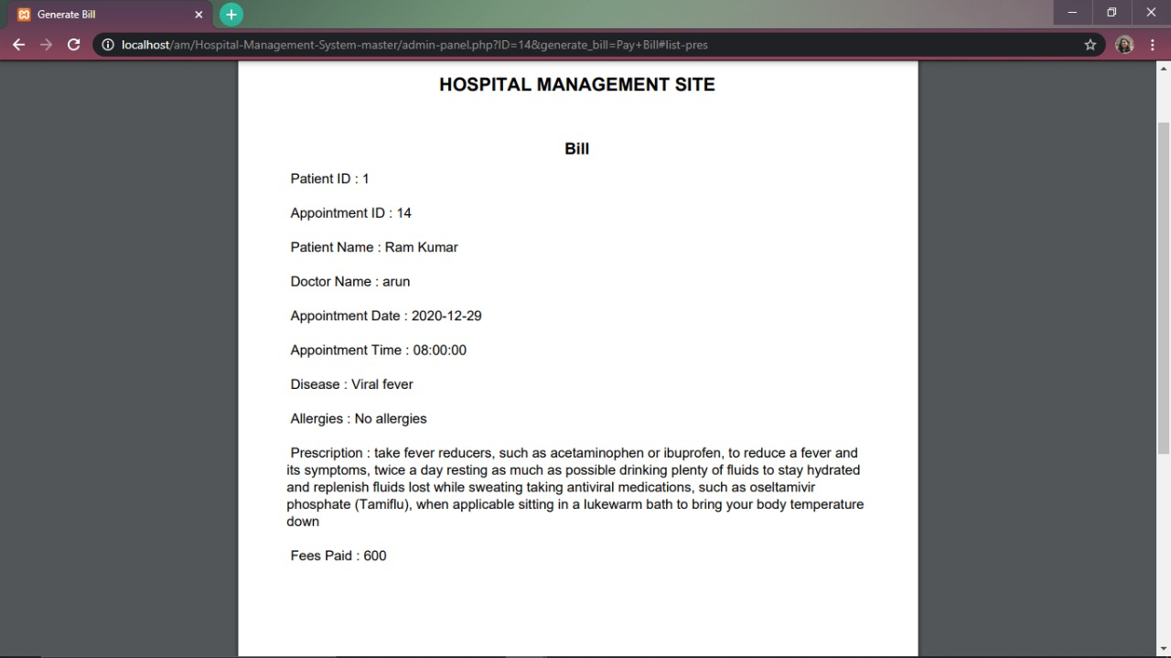

Slide 14
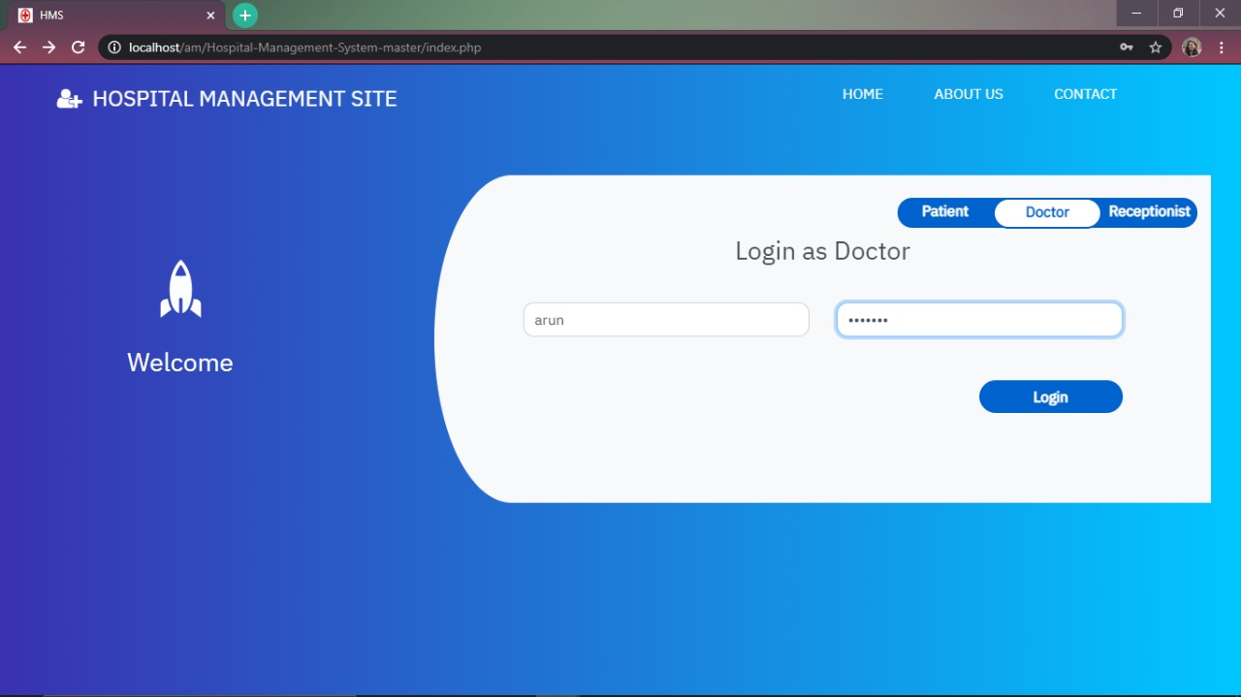

Slide 15
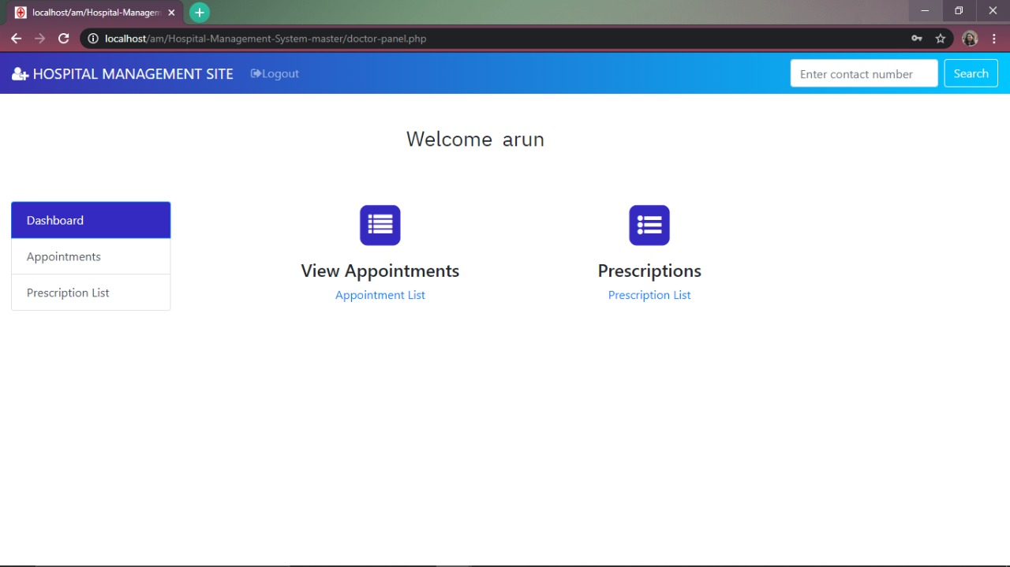

Slide 16
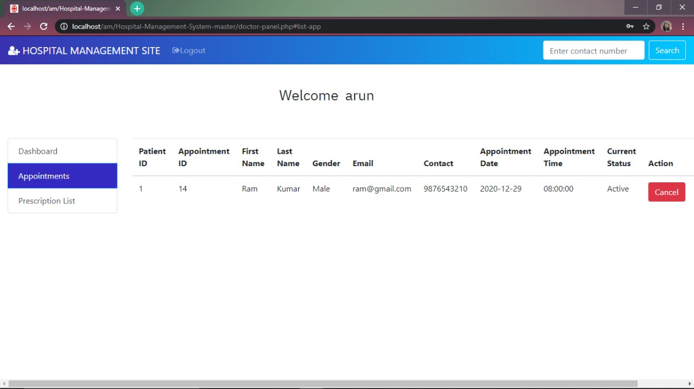

Slide 17
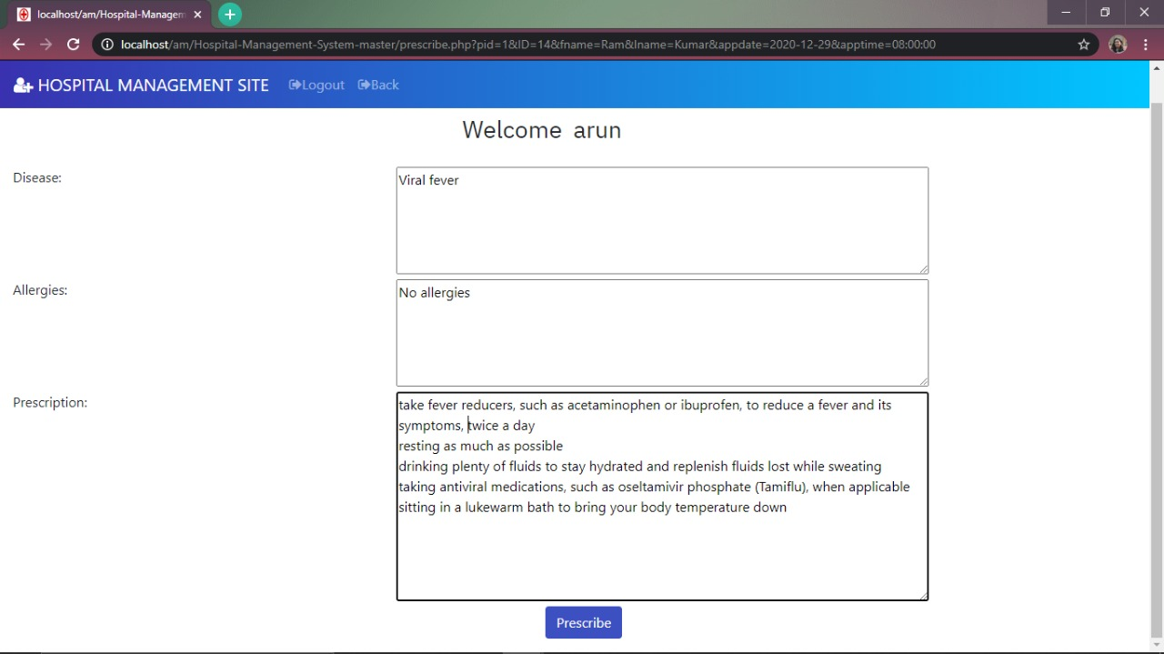

Slide 18
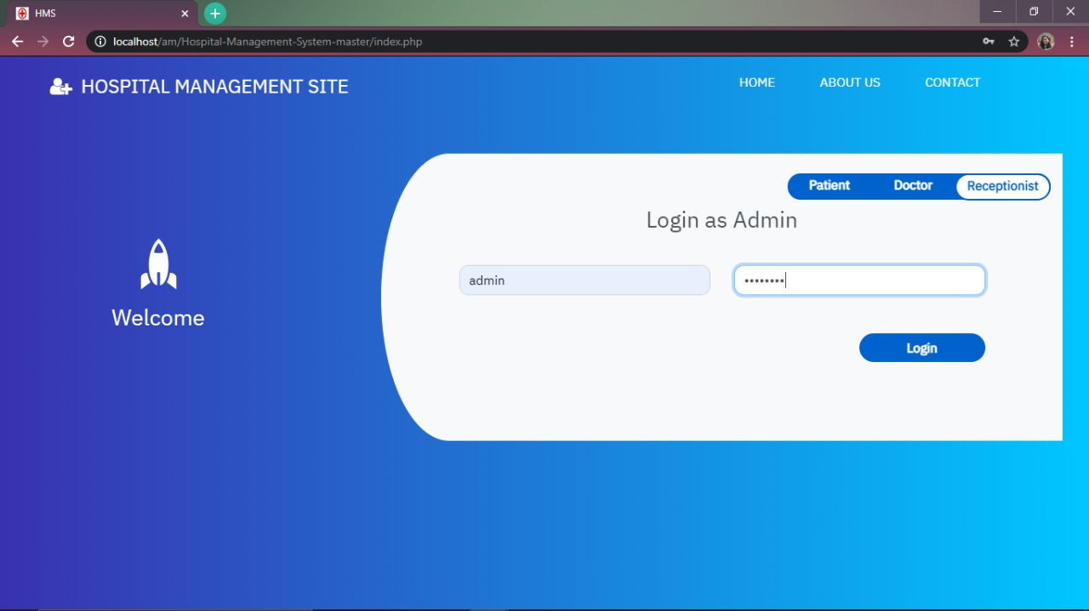

Slide 19
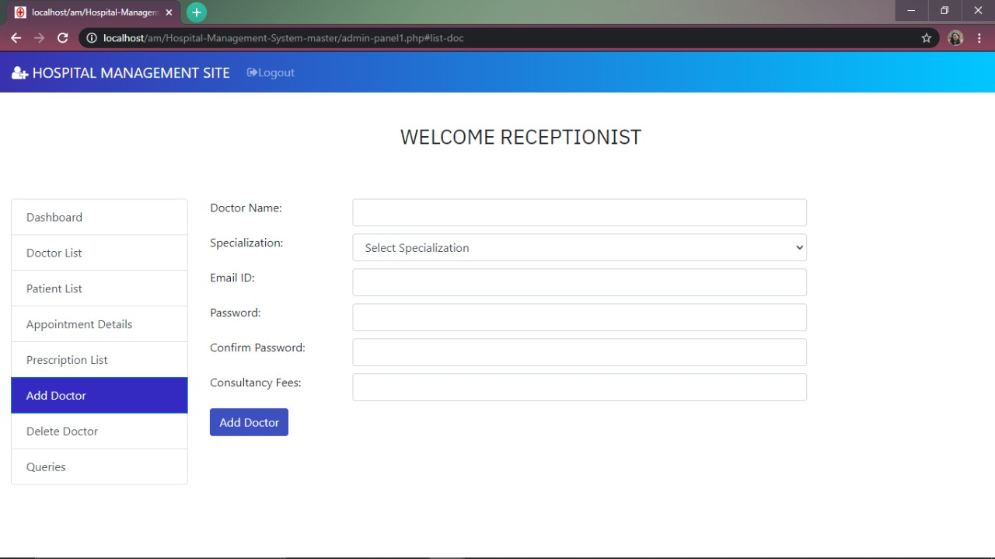

Slide 20
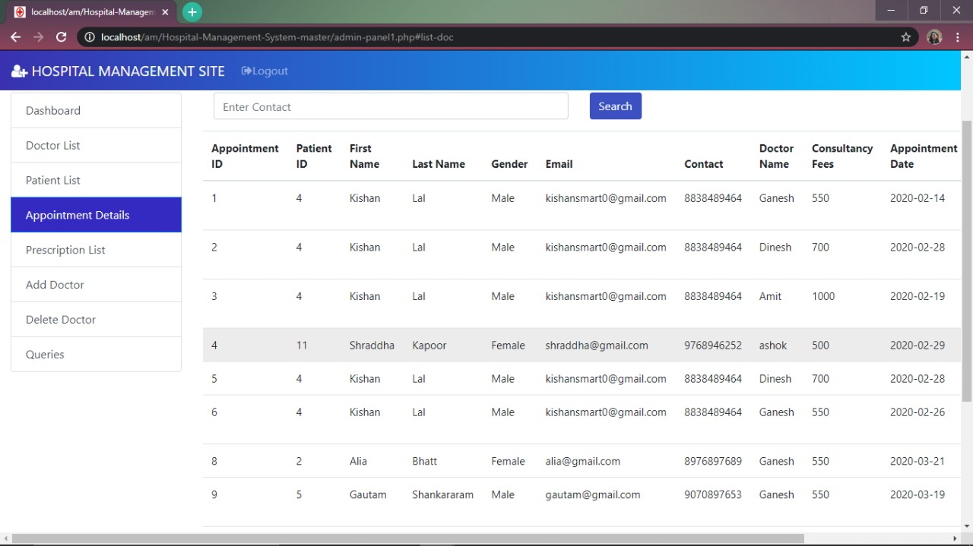

Slide 21
Since the System is essential for maintaining details about the Doctors and Patients. We understand that by using this Management System project the work becomes very easy and we save a lot of time. Hospital administrators would be able to significantly improve the operational control and thus streamline operations. This would enable to improve the response time to the demands of patient care because it automates the process of collecting, collating and retrieving patient information. Accounting sometimes becomes awfully pathetic and complex. This product will eliminate any such complexity
CONCLUSION

Slide 22


